Slide 1


Burglary and theft
Management system
Team Members:
Atharv Joshi (002817168)
Gargi Dongre (002831445)
L. Sai teja reddy (002337043)
Saipujitha (002321289)
Jiayu zhu (002875077)

Slide 2


OBJECTIVES
inefficient record keeping
data interconnectivity
delayed investigations
lack of reporting mechanisms
database system to manage and track crimes efficiently
gui for ease
insights through interactive dashboards
Problems Addressed
Goals

Slide 3




HIGH LEVEL DESIGN
User enters data through GUI
Key Design Considerations:
Security: Encrypted data and role-based access.
Scalability: Support for growing data volume.
Efficiency: Optimized queries for faster response times.
Data Integrity: Use of primary and foreign keys, triggers, and constraints.
GUI handles CRUD operations
Data stored in SQL Server
Approach:
Database layer: Centralized SQL database for secure storage.
Application layer: REST APIs for CRUD operations.
Presentation layer: User-friendly interfaces with reporting tools.
Reporting in PowerBI

Slide 4
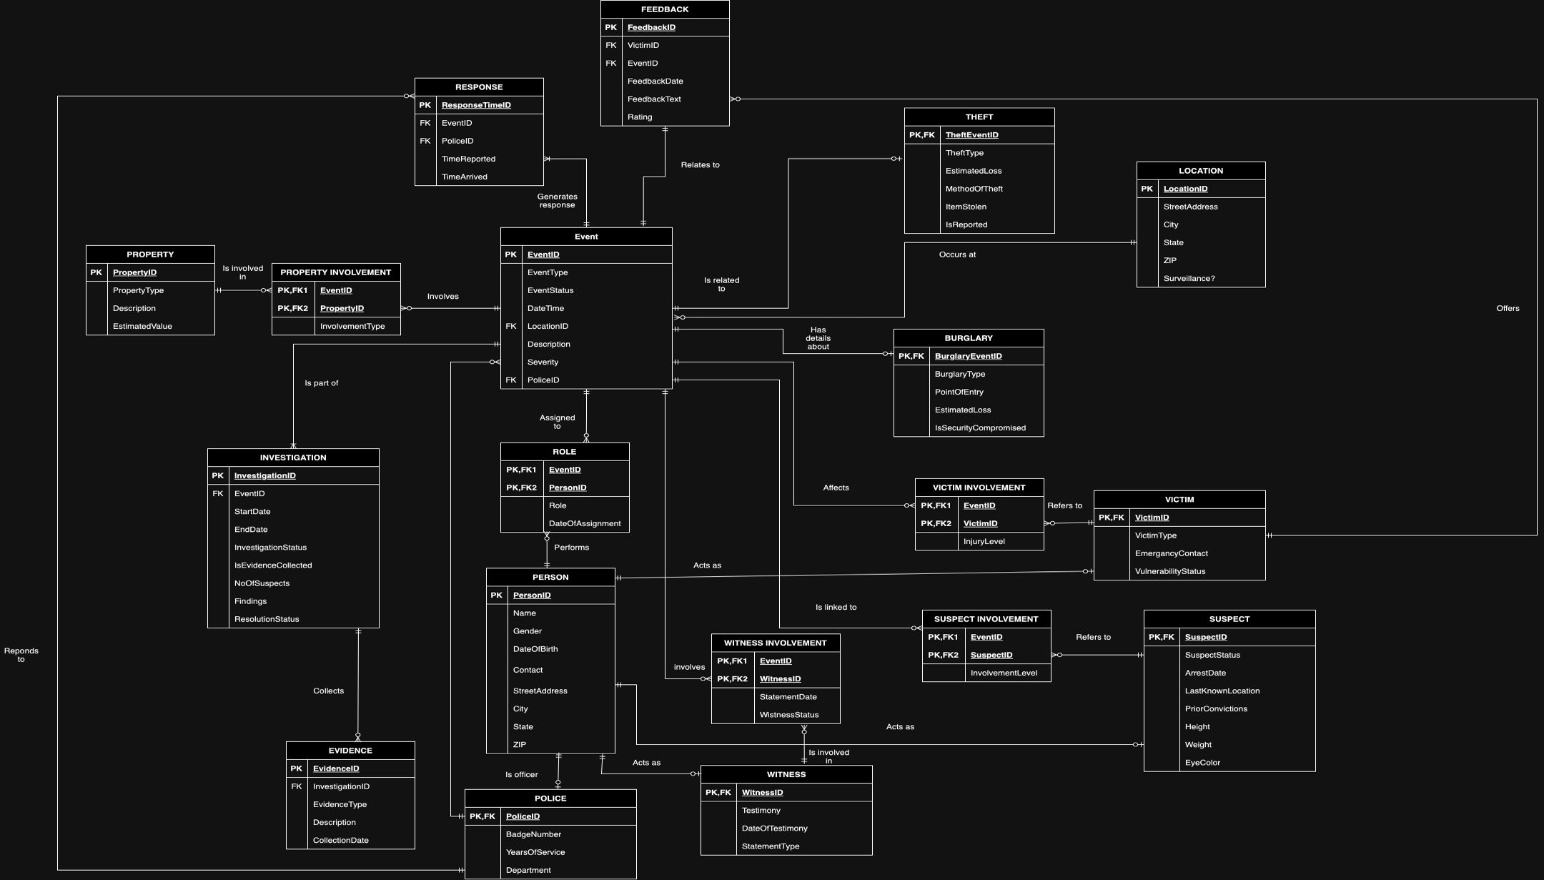

Slide 5

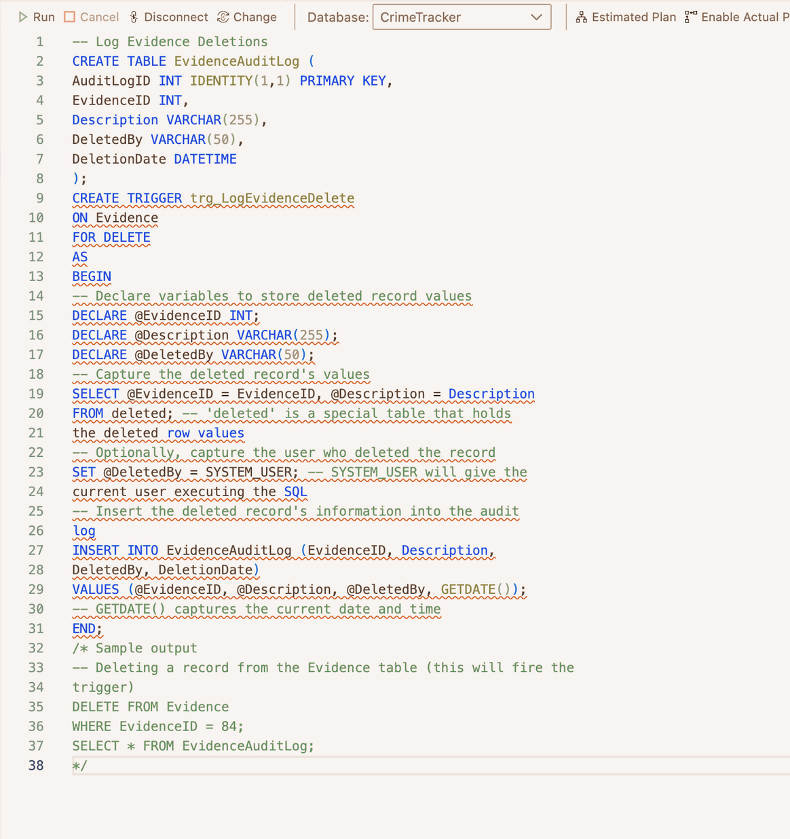
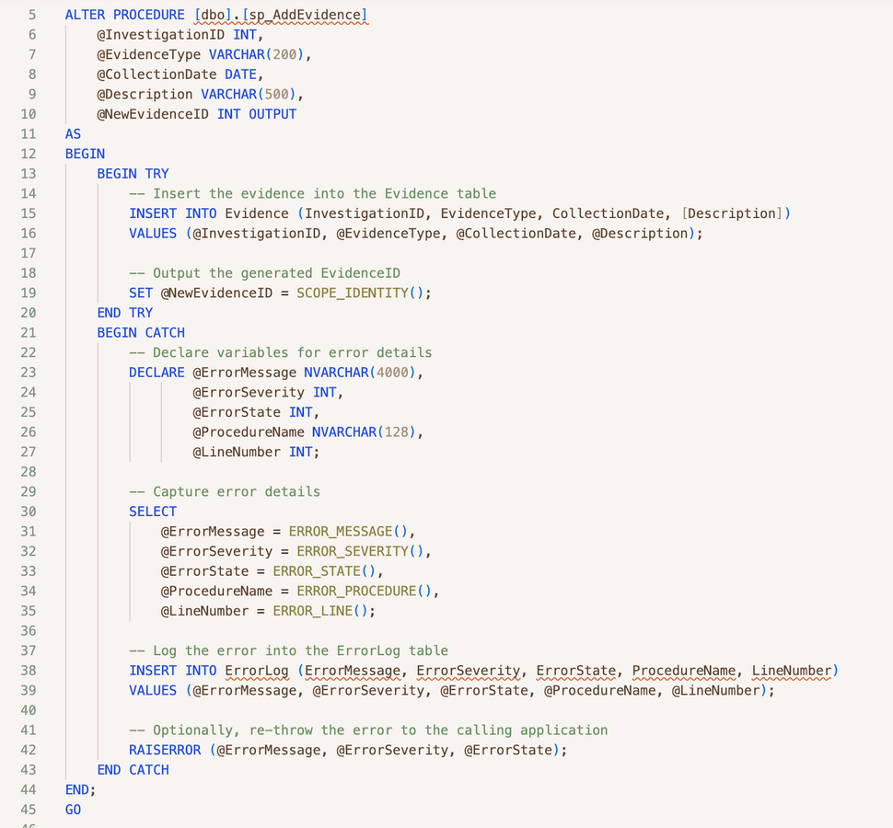

DATABSE OBJECTS

Slide 6
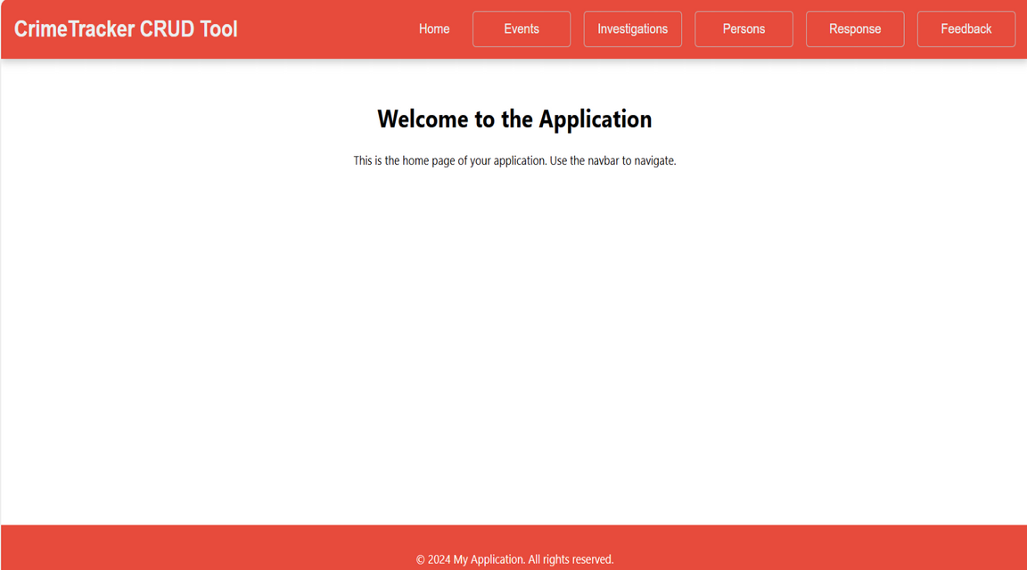
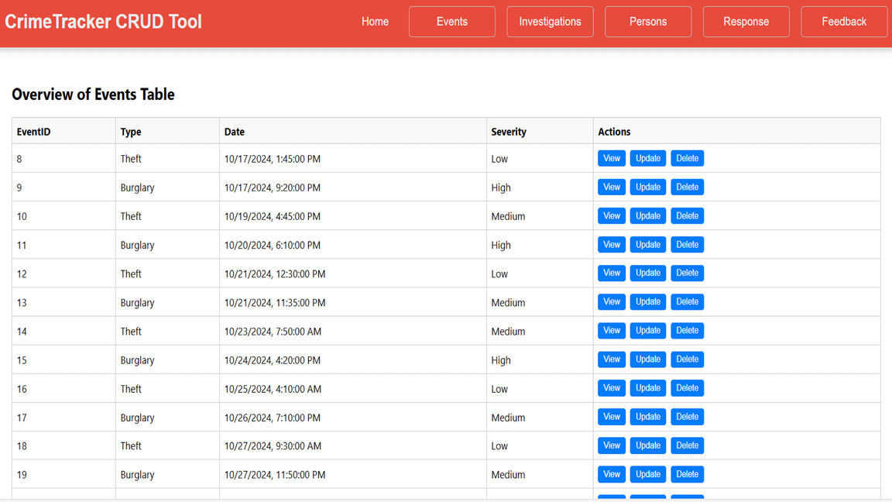
GUI

Slide 7
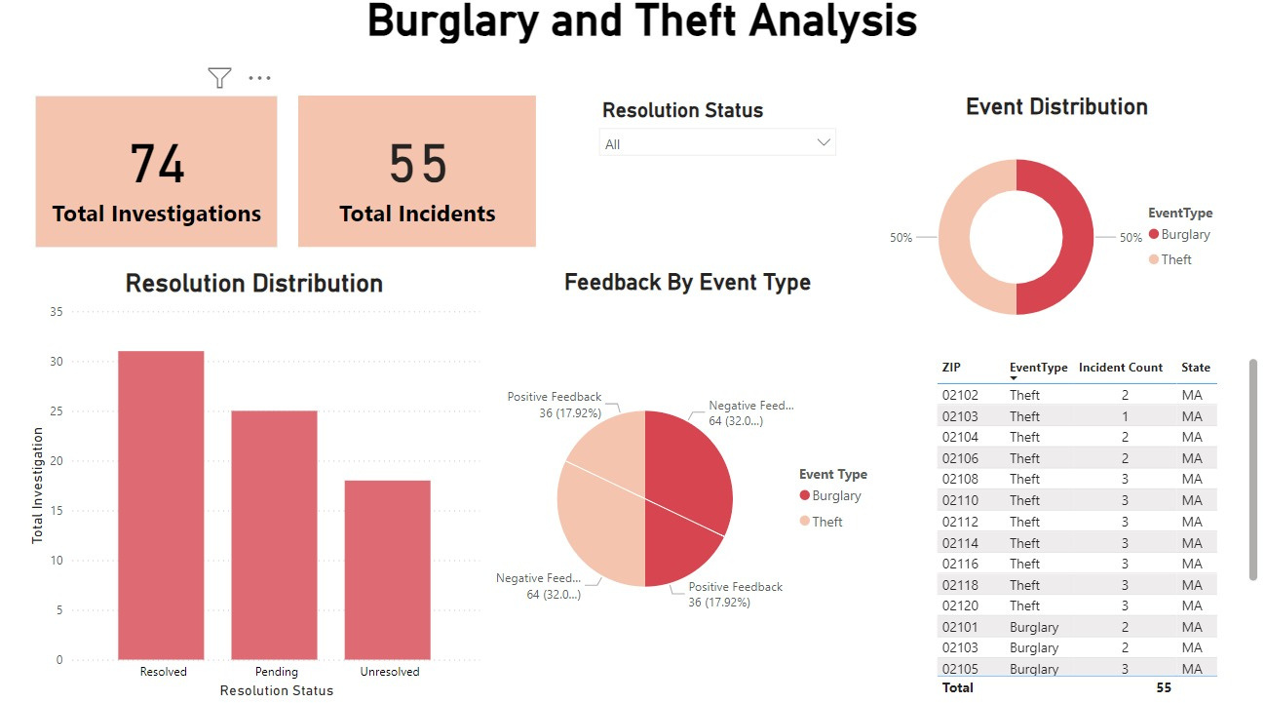
DASHBOARD

Slide 8

LIVE DEMO
THANK YOU

